Slide 1

COMPUTER GRAPHICS
Hochiminh city University of Technology
Faculty of Computer Science and Engineering
CHAPTER 06:
Transformations

Slide 2
OUTLINE
Introduction
Transformation in 2D
Transformation in 3D
Transformation in OpenGL

Slide 3
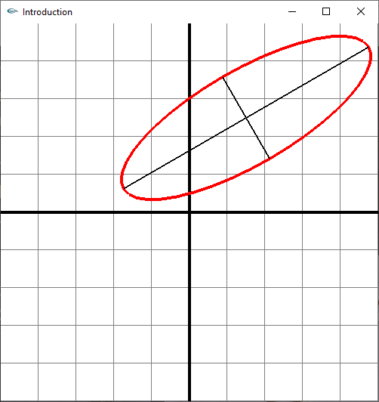
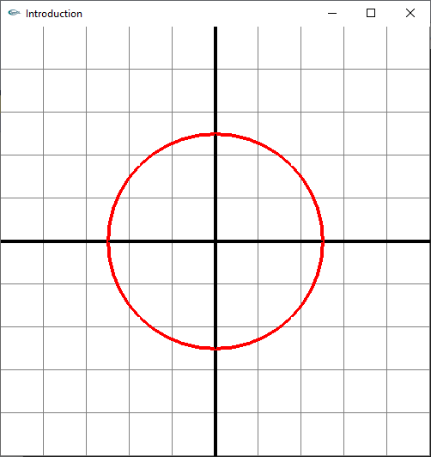
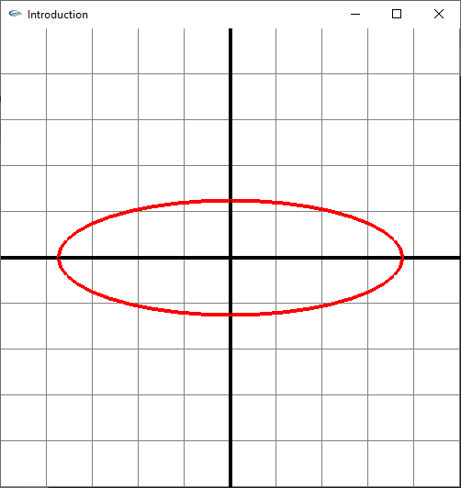
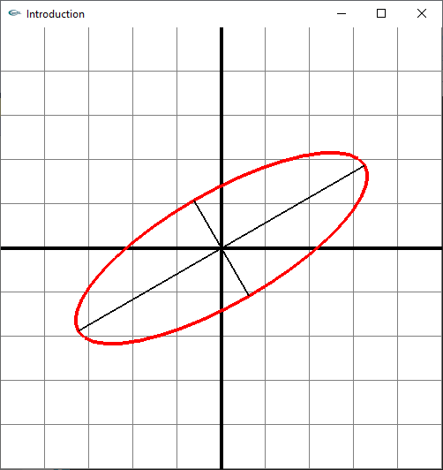

Introduction

Slide 4
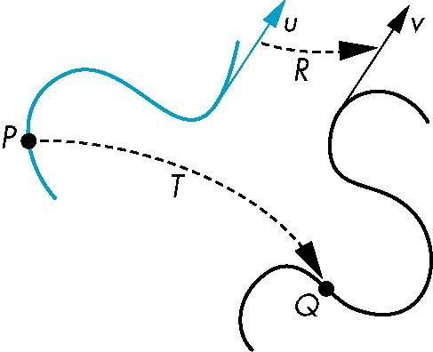
Introduction
General Transformations
A transformation maps points to other points and/or vectors to other vectors
v=T(u)
Q=T(P)

Slide 5
Introduction
General Transformations
P = (Px, Py, 1); Q = (Qx, Qy, 1) (Q - image)
(Qx, Qy, 1) = T (Px, Py, 1) (T – transformation)
Q = T(P).
a)
b)
y
y
Q
T
Q
P
P
0
x
x
z

Slide 6
Introduction
General Transformations
a)
b)
y
after
y
after
before
before
x
x

Slide 7
Introduction
Affine Transformations
Q_{x} = m₁₁P_{x} +m₁₂P_{y} +m₁₃
Q_{y} = m₂₁P_{x} +m₂₂P_{y} +m₂₃
always (0, 0, 1)
T

Slide 8
Introduction
Affine Transformations
Line preserving
Characteristic of many physically important transformations
Rigid body transformations: rotation, translation
Scaling, shear
Importance in graphics is that we need only transform endpoints of line segments and let implementation draw line segment between the transformed endpoints

Slide 9
Introduction
Pipeline Implementation
glBegin(GL_LINES);
glVertex3f(. . .);
glVertex3f(. . .);
glVertex3f(. . .);
glEnd();
P₁, P₂,...
Q₁, Q₂,...
CT
y
P₃
y
P₂
P₁
z
x
z
x

Slide 10

Transformations in 2D
Translation
Qx = Px + m13
Qy = Py + m23
y
y
1
x
x
2

Slide 11
Transformations in 2D
Scaling
Qx = Sx Px
Qy = Sy Py
y
uniform
y
x
y
Non-uniform
x
x

Slide 12
Transformations in 2D
Scaling (Reflection)
y
y
x
y
x
x

Slide 13
Transformations in 2D
Scaling (Reflection)
y
x

Slide 14
Transformations in 2D
Rotation
Q_{x} = P_{x} cos(θ) – P_{y} sin(θ)
Q_{y} = P_{x} sin(θ) + P_{y} cos(θ)
y
y
x
60⁰
x

Slide 15
Transformations in 2D
Rotation
y
Q
R
P
θ
ϕ
x

Slide 16
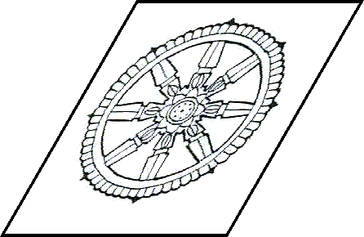
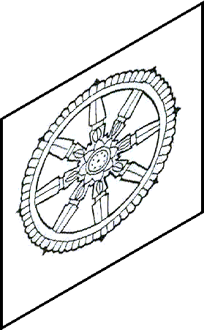
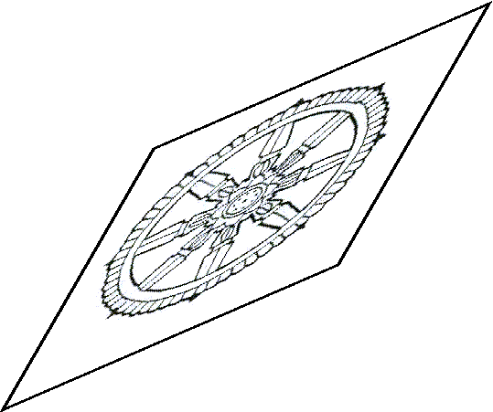
Transformations in 2D
y
Shear
x
y
y
x
x
y
x

Slide 17
Transformations in 2D
Concatenation
y
Q
T₁()
T₂()
P
W
T()
x

Slide 18
Transformations in 2D
Concatenation
We can form arbitrary affine transformation matrices by multiplying together rotation, translation, and scaling matrices
Because the same transformation is applied to many vertices, the cost of forming a matrix M=ABCD is not significant compared to the cost of computing Mp for many vertices p

Slide 19
Transformations in 2D
Concatenation
Note that matrix on the right is the first applied
Mathematically, the following are equivalent
W = T₂ Q = T₂ (T₁ P) = (T₂ T₁ )P
y
Q
T₁()
T₂()
P
W
T()
x

Slide 20

Transformations in 2D
Concatenation
- Move fixed point to origin
- Rotate
- Move fixed point back
- M = T(p_{f}) R(θ) T(-p_{f})
Q
Q’
θ
P
V
θ
P’

Slide 21
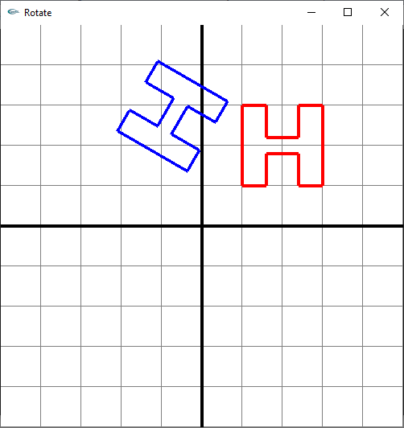
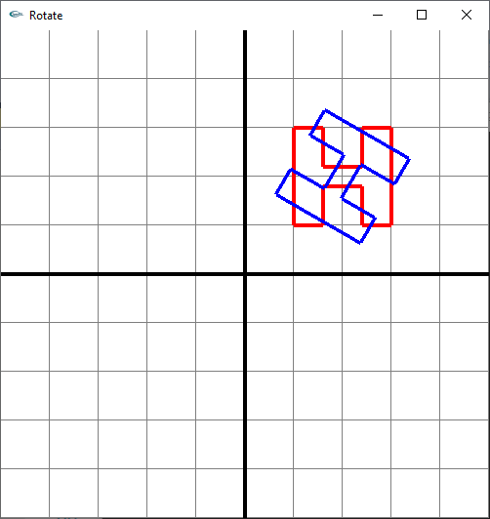
Transformations in 2D

Slide 22
Transformations in 3D
General Formula

Slide 23
Transformations in 3D
Translation
Scaling
y
y
z
x
z
x

Slide 24
Transformations in 3D
Shear
Q = (P_{x}, fP_{x} + P_{y}, P_{z} )
Rotation
y
x-roll, y-roll, z-roll
when angle = 90⁰:
z-roll: x→y
x-roll: y→z
y-roll: z→x
P’
Q’
Q’’
Q
P
P’’
z
x

Slide 25
Transformations in 3D
Rotation
a) object
b) Rotate about Ox (- 70⁰)
c) Rotate about Oy (30⁰)
d) Rotate aboute Oz (- 90⁰)
y
y
y
y
z
x
z
x
z
x
z
x

Slide 26
Transformations in 3D
Rotation about an Arbitrary Axis
y
u → x.
Rotate about x axis with angle β.
recover u.
u
Q
β
P
φ
z
θ
x

Slide 27
Transformations in 3D
y
u
u → x
Rotate u around y (+θ)
Then rotate around z (-φ)
Rotate around x (+β)
Recover u
Rotate around z (+φ)
Rotate around y (-θ)
Q
β
P
φ
z
θ
x
R_{u}(β)=R_{y}(-θ)R_{z}(φ)R_{x}(β)R_{z}(-φ)R_{y}(θ)

Slide 28
Transformations in 3D
y
u
Q
β
P
R_{u}(β)=R_{y}(-θ)R_{z}(φ)R_{x}(β)R_{z}(-φ)R_{y}(θ)
φ
z
θ
x

Slide 29
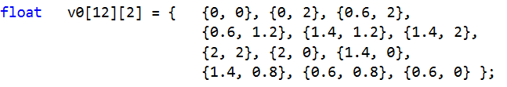
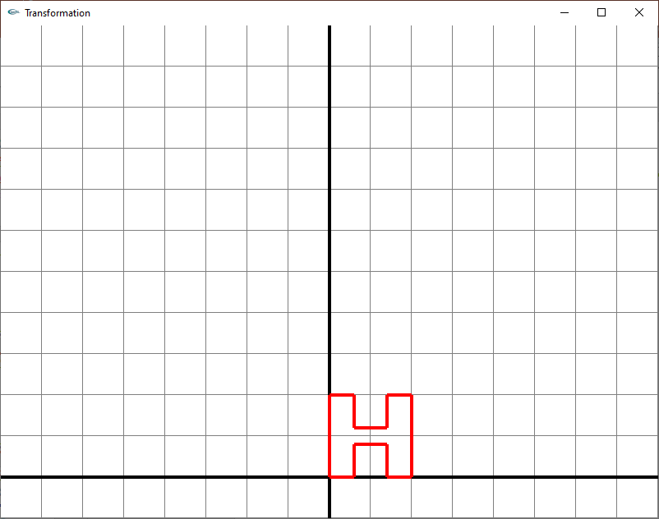
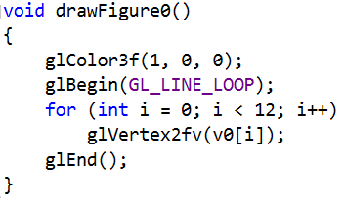
Transformations in OpenGL
How to draw this picture (the red letter H)

Slide 30
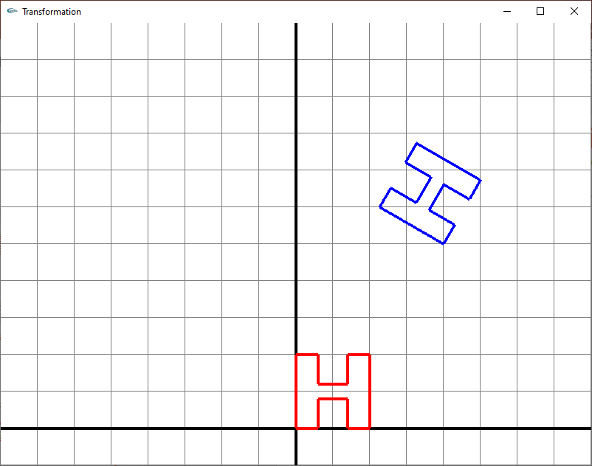
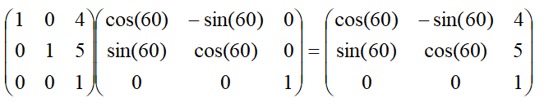
Transformations in OpenGL
How to draw the blue H

Slide 31
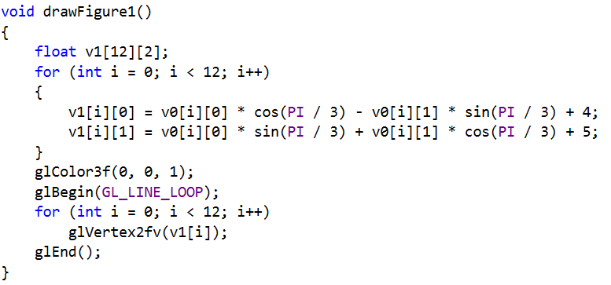
Transformations in OpenGL
How to draw the blue H

Slide 32
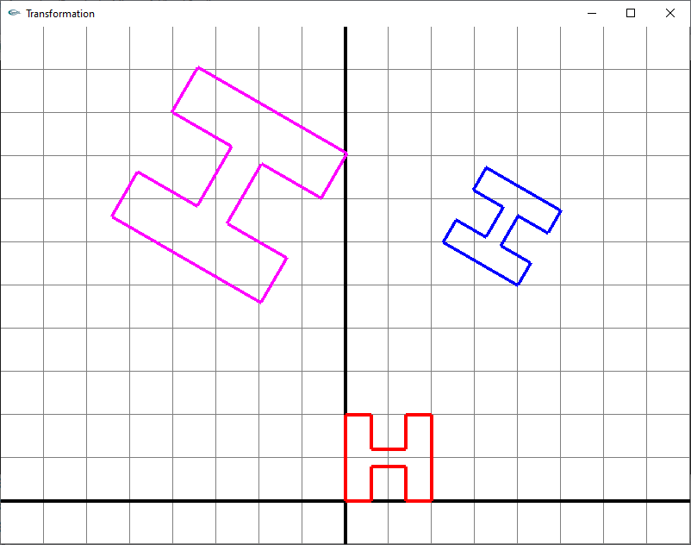
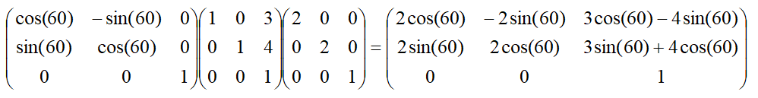
Transformations in OpenGL
How to draw the purple H

Slide 33
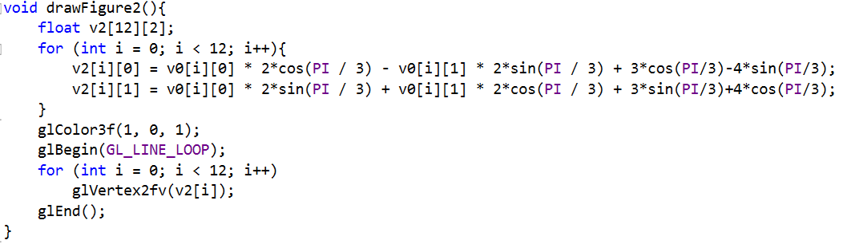
Transformations in OpenGL
How to draw the purple H

Slide 34

Transformations in OpenGL
How to draw the blue H

Slide 35
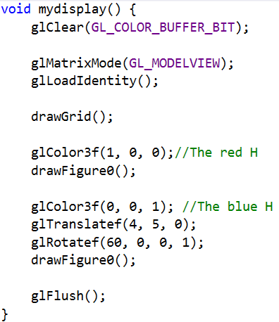
Transformations in OpenGL

Slide 36
Transformations in OpenGL
glMatrixMode(GL_MODELVIEW);
glLoadIdentity(); CTM = I
drawFigure0();
CTM: Current Transf. Matrix
S_{y}
V
Q
S
S
CTM
W→V
V
S_{x}
Q

Slide 37
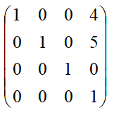
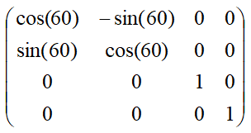
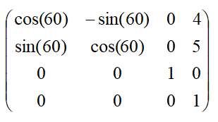
Transformations in OpenGL
glMatrixMode(GL_MODELVIEW);
glLoadIdentity(); CTM = I
glColor3f(1, 0, 0); CTM = CTM* =
drawFigure0();
glColor3f(0, 0, 1);
glTranslatef(4, 5, 0); CTM = CTM* =
glRotatef(60, 0, 0, 1);
drawFigure0();

Slide 38
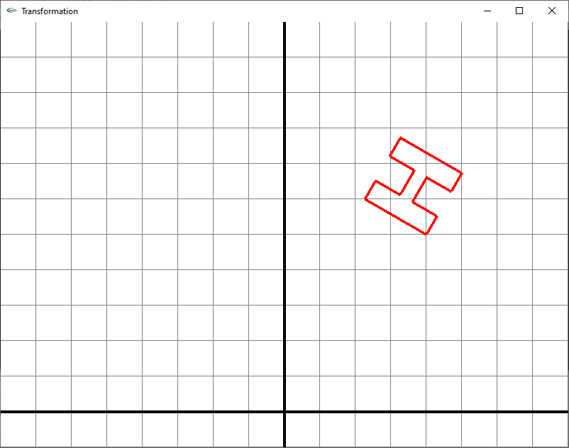
Transformations in OpenGL
glMatrixMode(GL_MODELVIEW);
glLoadIdentity();
drawGrid();
glColor3f(0, 0, 1);
glTranslatef(4, 5, 0);
glRotatef(60, 0, 0, 1);
drawFigure0();
glColor3f(1, 0, 0);
drawFigure0();

Slide 39
Transformations in OpenGL
glMatrixMode(GL_MODELVIEW);
glLoadIdentity(); CTM = I
glColor3f(0, 0, 1);
glTranslatef(4, 5, 0); CTM =
glRotatef(60, 0, 0, 1);
drawFigure0();
glColor3f(1, 0, 0);
drawFigure0();

Slide 40
Transformations in OpenGL
glMatrixMode(GL_MODELVIEW);
glLoadIdentity(); CTM = I
glPushMatrix();
glColor3f(0, 0, 1);//The blue H
glTranslatef(4, 5, 0); CTM =
glRotatef(60, 0, 0, 1);
drawFigure0();
glPopMatrix();
glColor3f(1, 0, 0);//The red H CTM = I
drawFigure0();
I

Slide 41
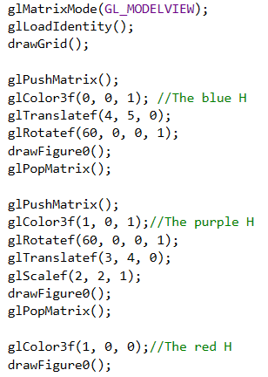
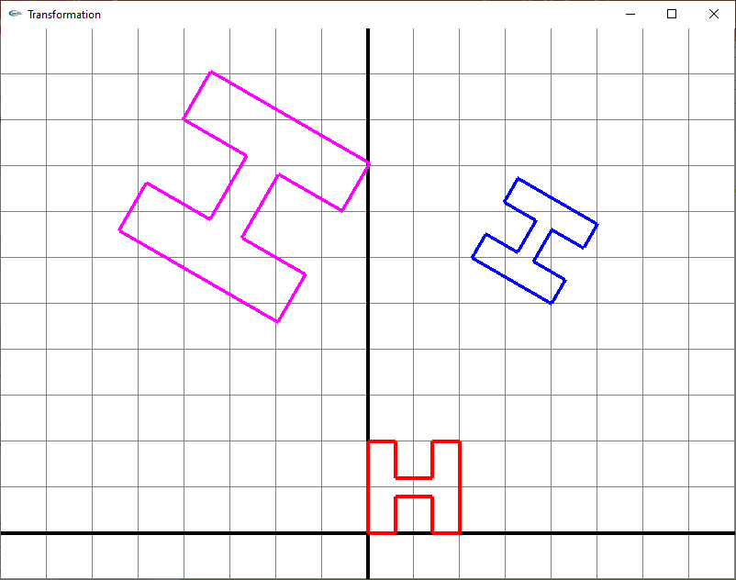
Transformations in OpenGL

Slide 42
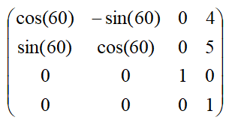
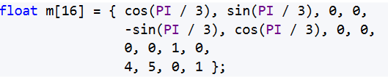
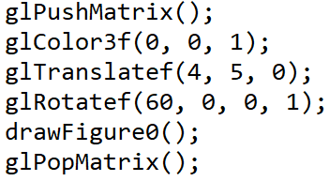
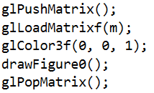
Transformations in OpenGL
Draw the blue H

Slide 43
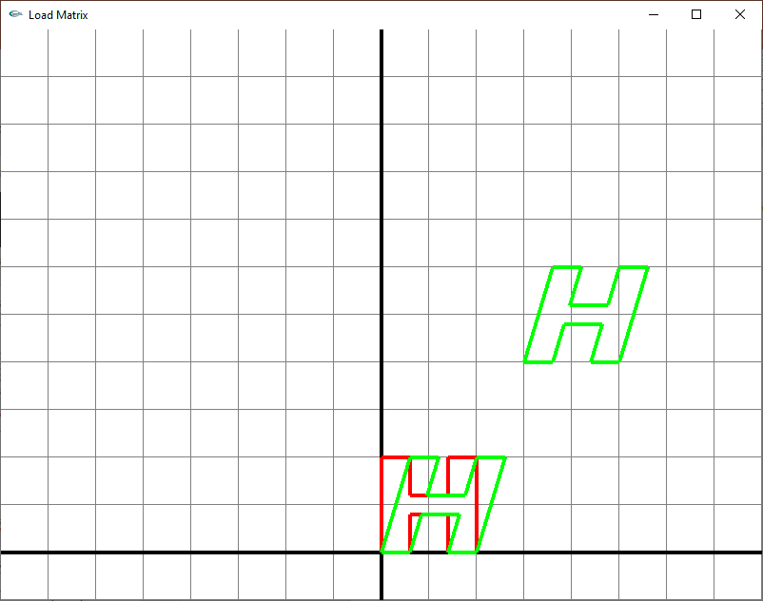
Transformations in OpenGL

Slide 44
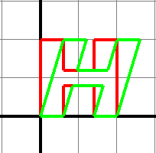
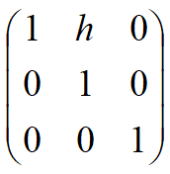
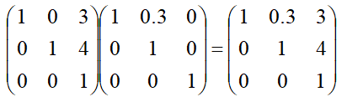
Transformations in OpenGL
Qx = Px + hPy (Qx, Qy) = (0.6, 2.0); (Px, Py) = (0, 2.0)
0.6 = 0 + 2h → h = 0.3

Slide 45
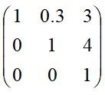
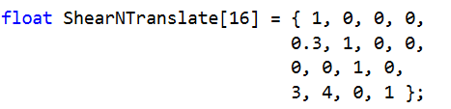
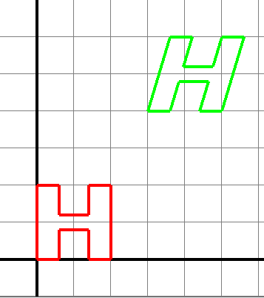
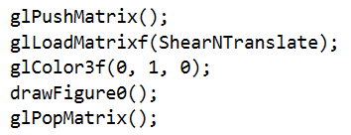
Transformations in OpenGL

Slide 46
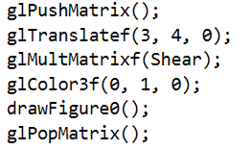
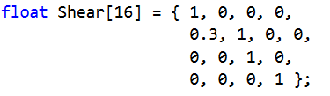
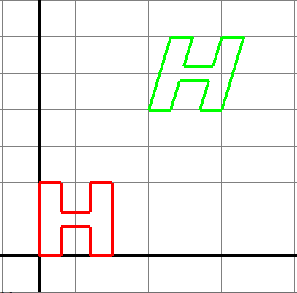
Transformations in OpenGL
glMultMatrixf

Slide 47
Transformations in OpenGL
Load an identity matrix:
glLoadIdentity()
Rotation, Translation, Scaling
glRotatef(theta, vx, vy, vz)
theta in degrees, (vx, vy, vz) define axis of rotation
glTranslatef(dx, dy, dz)
glScalef( sx, sy, sz)

Slide 48
Transformations in OpenGL
Can load and multiply by matrices defined in the application program
glLoadMatrixf(m)
glMultMatrixf(m)
The matrix m is a one dimension array of 16 elements which are the components of the desired 4 x 4 matrix stored by columns
In glMultMatrixf, m multiplies the existing matrix on the right

Slide 49
Transformations in OpenGL
Reading Back Matrices
Can also access matrices (and other parts of the state) by query functions
glGetIntegerv
glGetFloatv
glGetBooleanv
glGetDoublev
glIsEnabled
For matrices, we use as
float m[16];
glGetFloatv(GL_MODELVIEW_MATRIX, m);

Slide 50
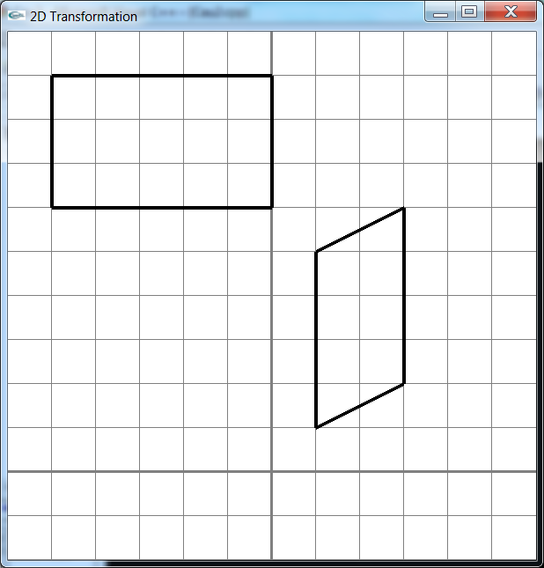
Transformations in OpenGL
B’
C’
C
A’
D’
B
D
A
Tìm ma trận biến đổi hình bình hành thành hình chữ nhật

Slide 51
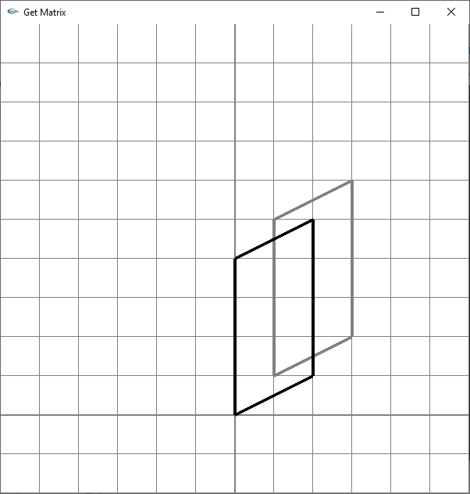
Transformations in OpenGL

Slide 52
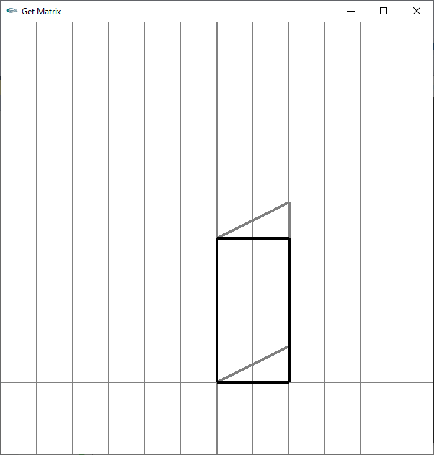
Transformations in OpenGL
Qy = gPx + Py
(2, 1) → (2, 0)
0 = 2g + 1 → g = -0.5

Slide 53
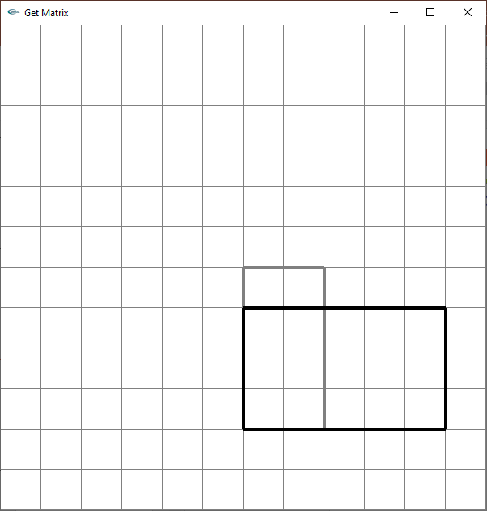
Transformations in OpenGL

Slide 54
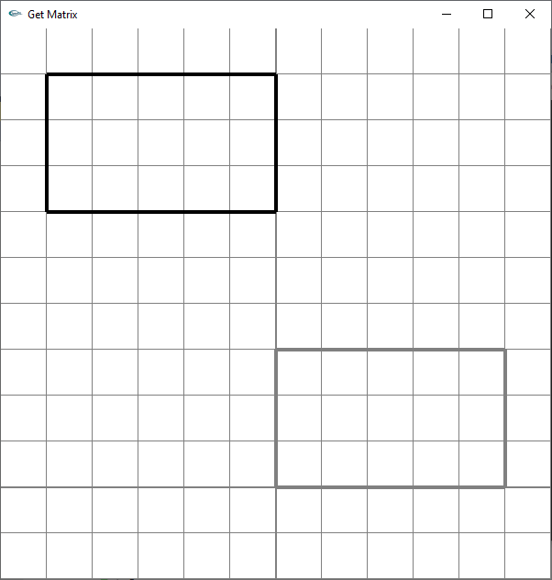
Transformations in OpenGL

Slide 55
Transformations in OpenGL
Tịnh tiến (M1)
Trượt theo trục y (M2)
Tỷ lệ (M3)
Tịnh tiến (M4)

Slide 56
Transformations in OpenGL
M = M4*M3*M2*M1

Slide 57
Transformations in OpenGL
M = M4*M3*M2*M1
B’
C’
C
A’
D’
B
D
A

Slide 58
Transformations in OpenGL
C’
Q_{x} = m₁₁P_{x} +m₁₂P_{y} +m₁₃
Q_{y} = m₂₁P_{x} +m₂₂P_{y} +m₂₃
B’
C
-5 = m11 + m12 + m13
6 = m21 + m22 + m23
0 = 3m11+ 6m12 + m13
9 = 3m21 + 6m22 + m23
0 = 3m11 + 2m12 + m13
6 = 3m21 + 2m22 + m23
A’
D’
B
D
A
m11 = 5/2, m12 = 0, m13 = -15/2
m21 = -3/8, m22= 3/4,m23 = 45/8

Slide 59
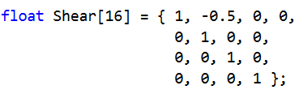

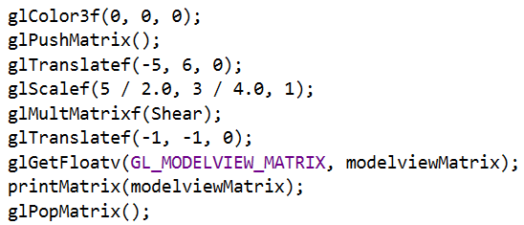
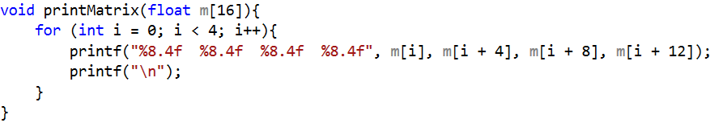
Transformations in OpenGL

